Slide 1
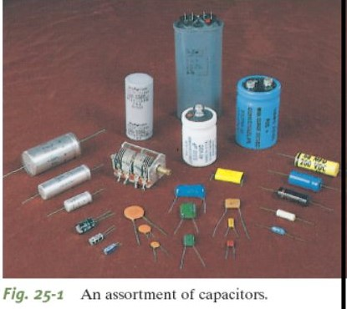
Chapter Five
Capacitance

Slide 2
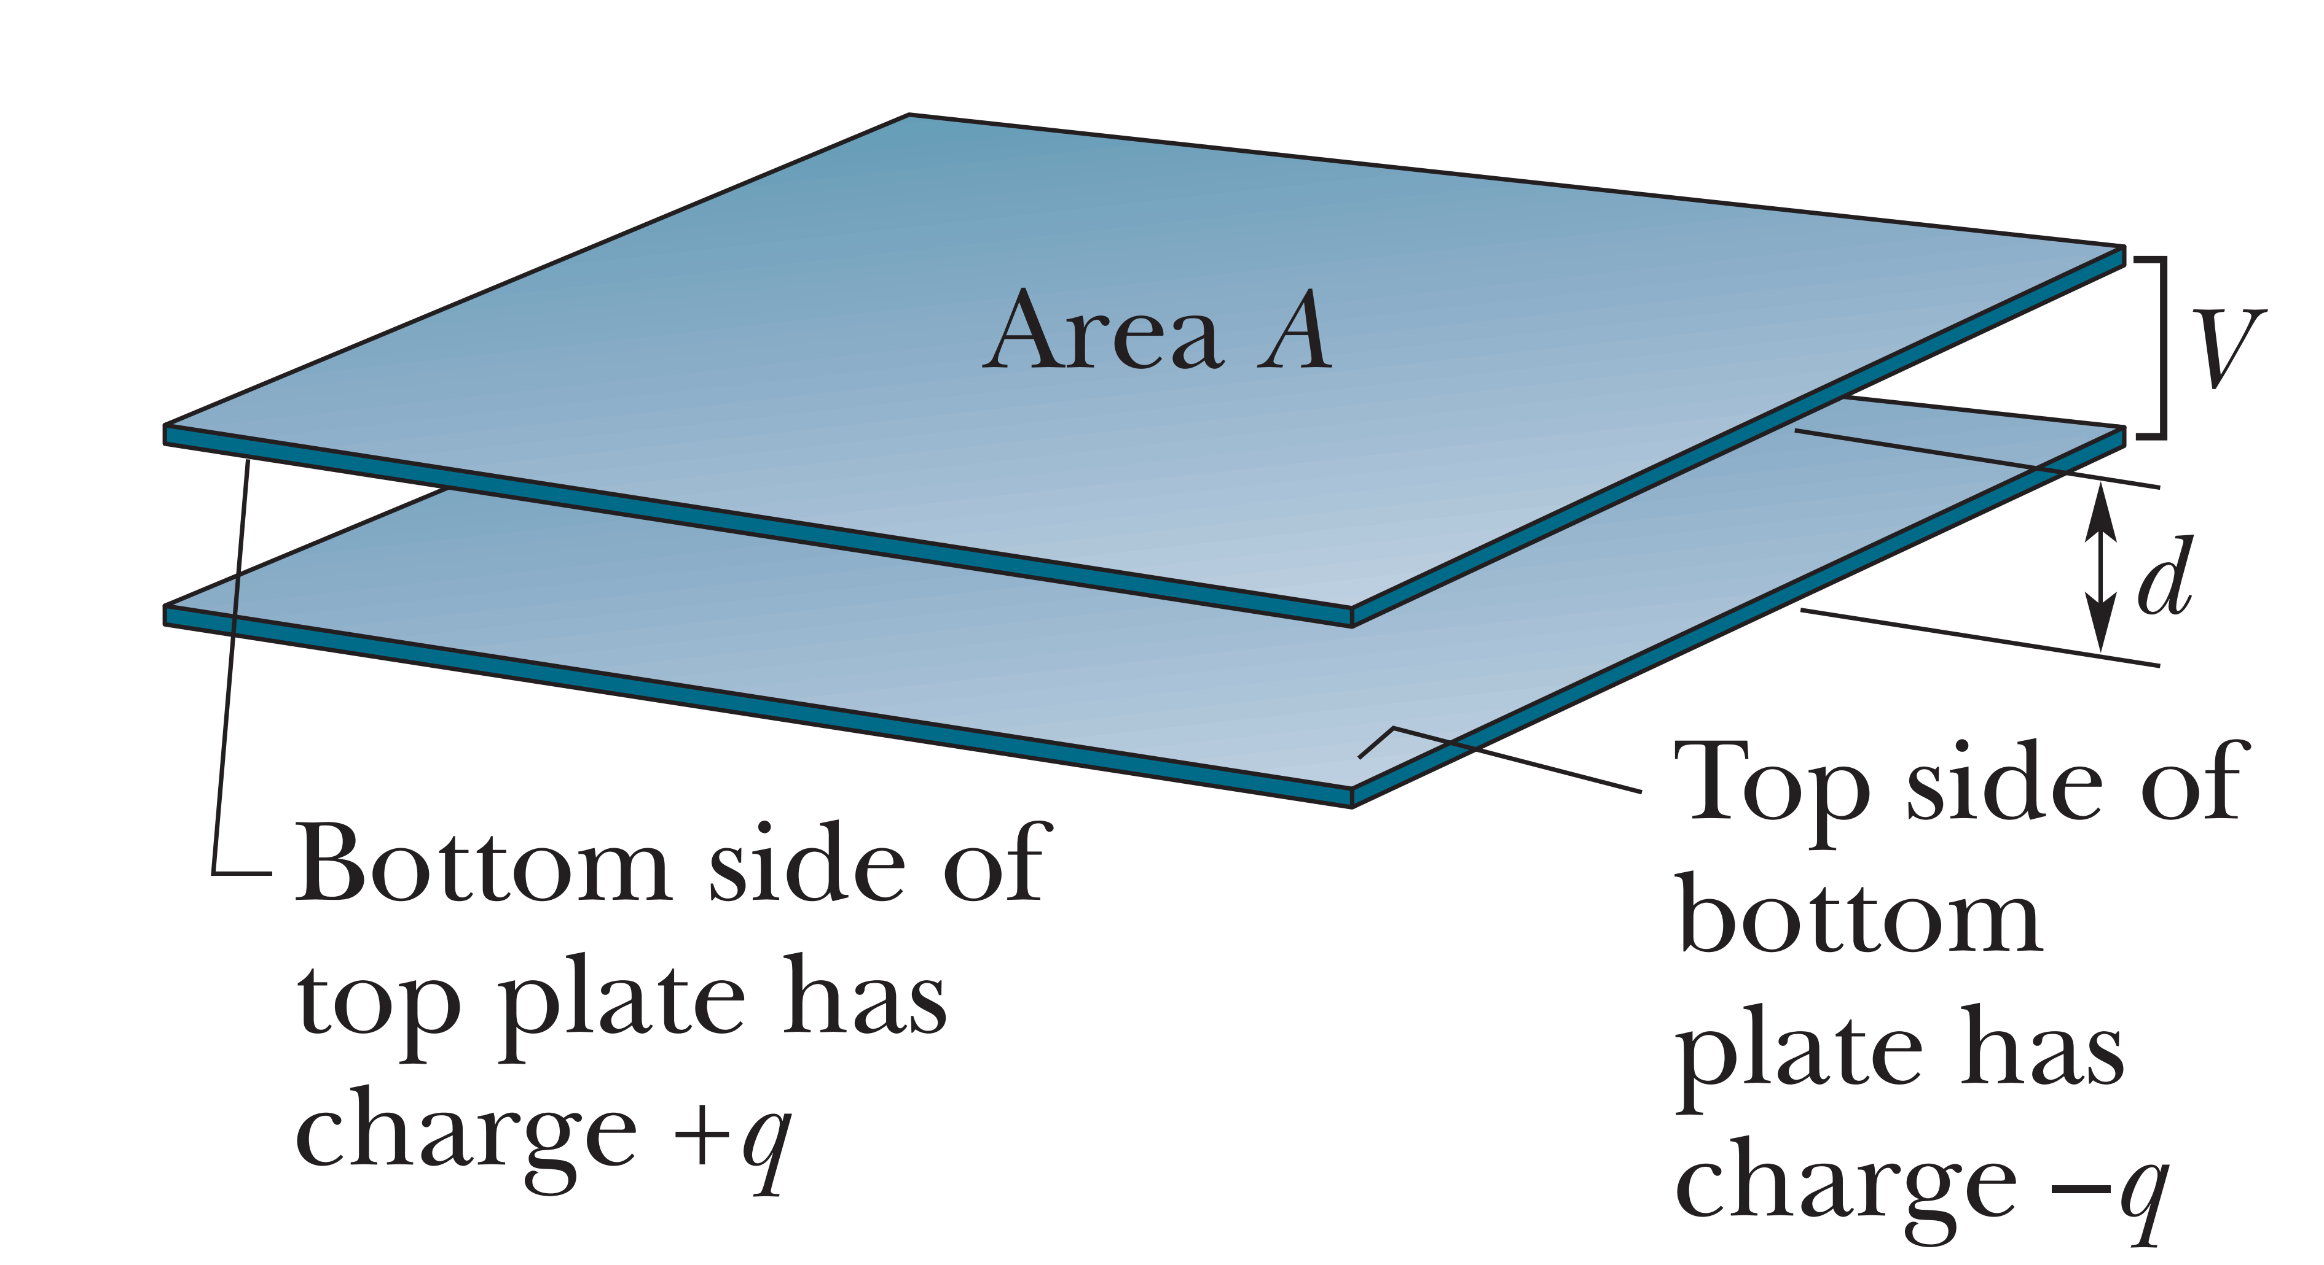
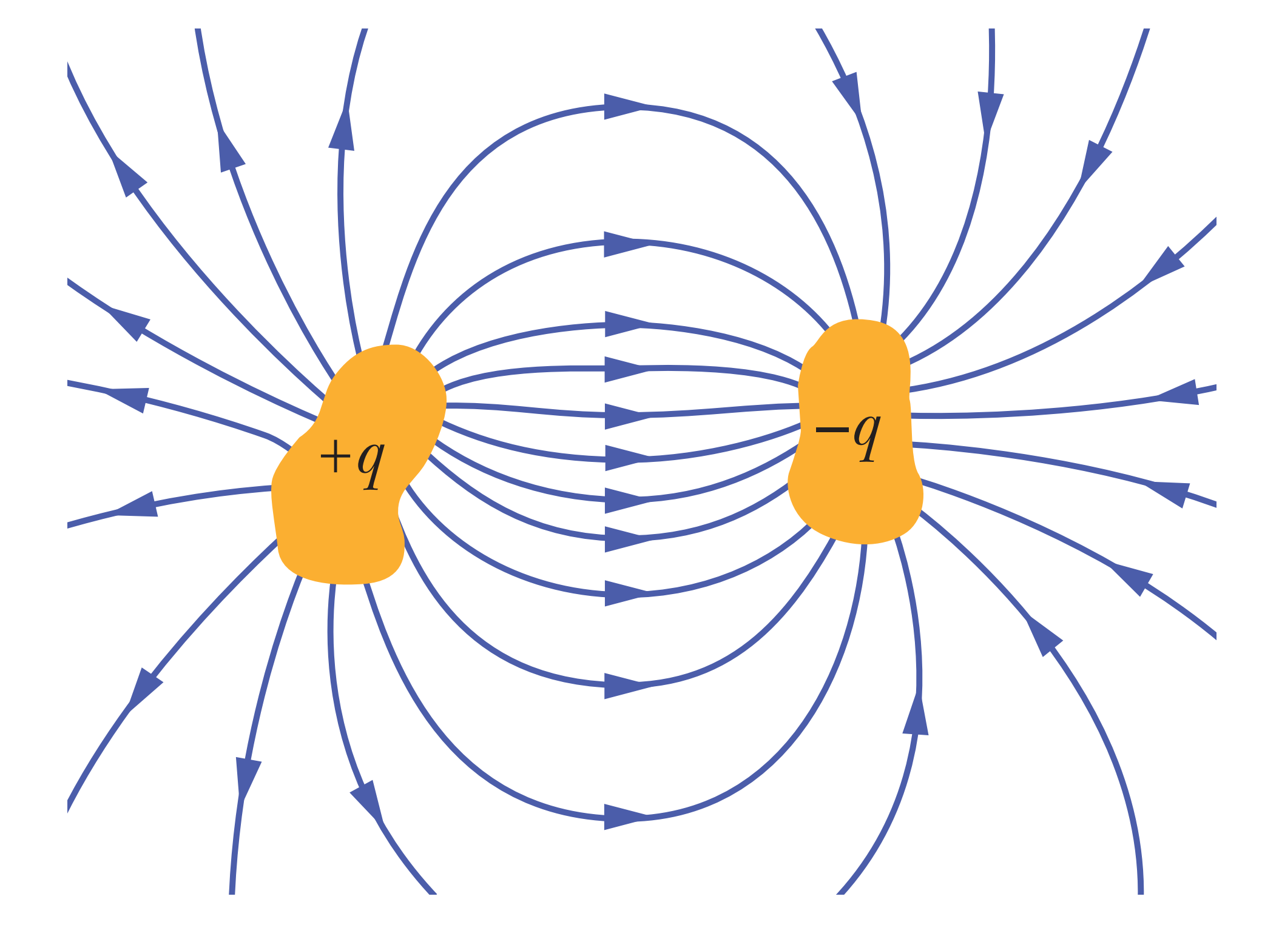
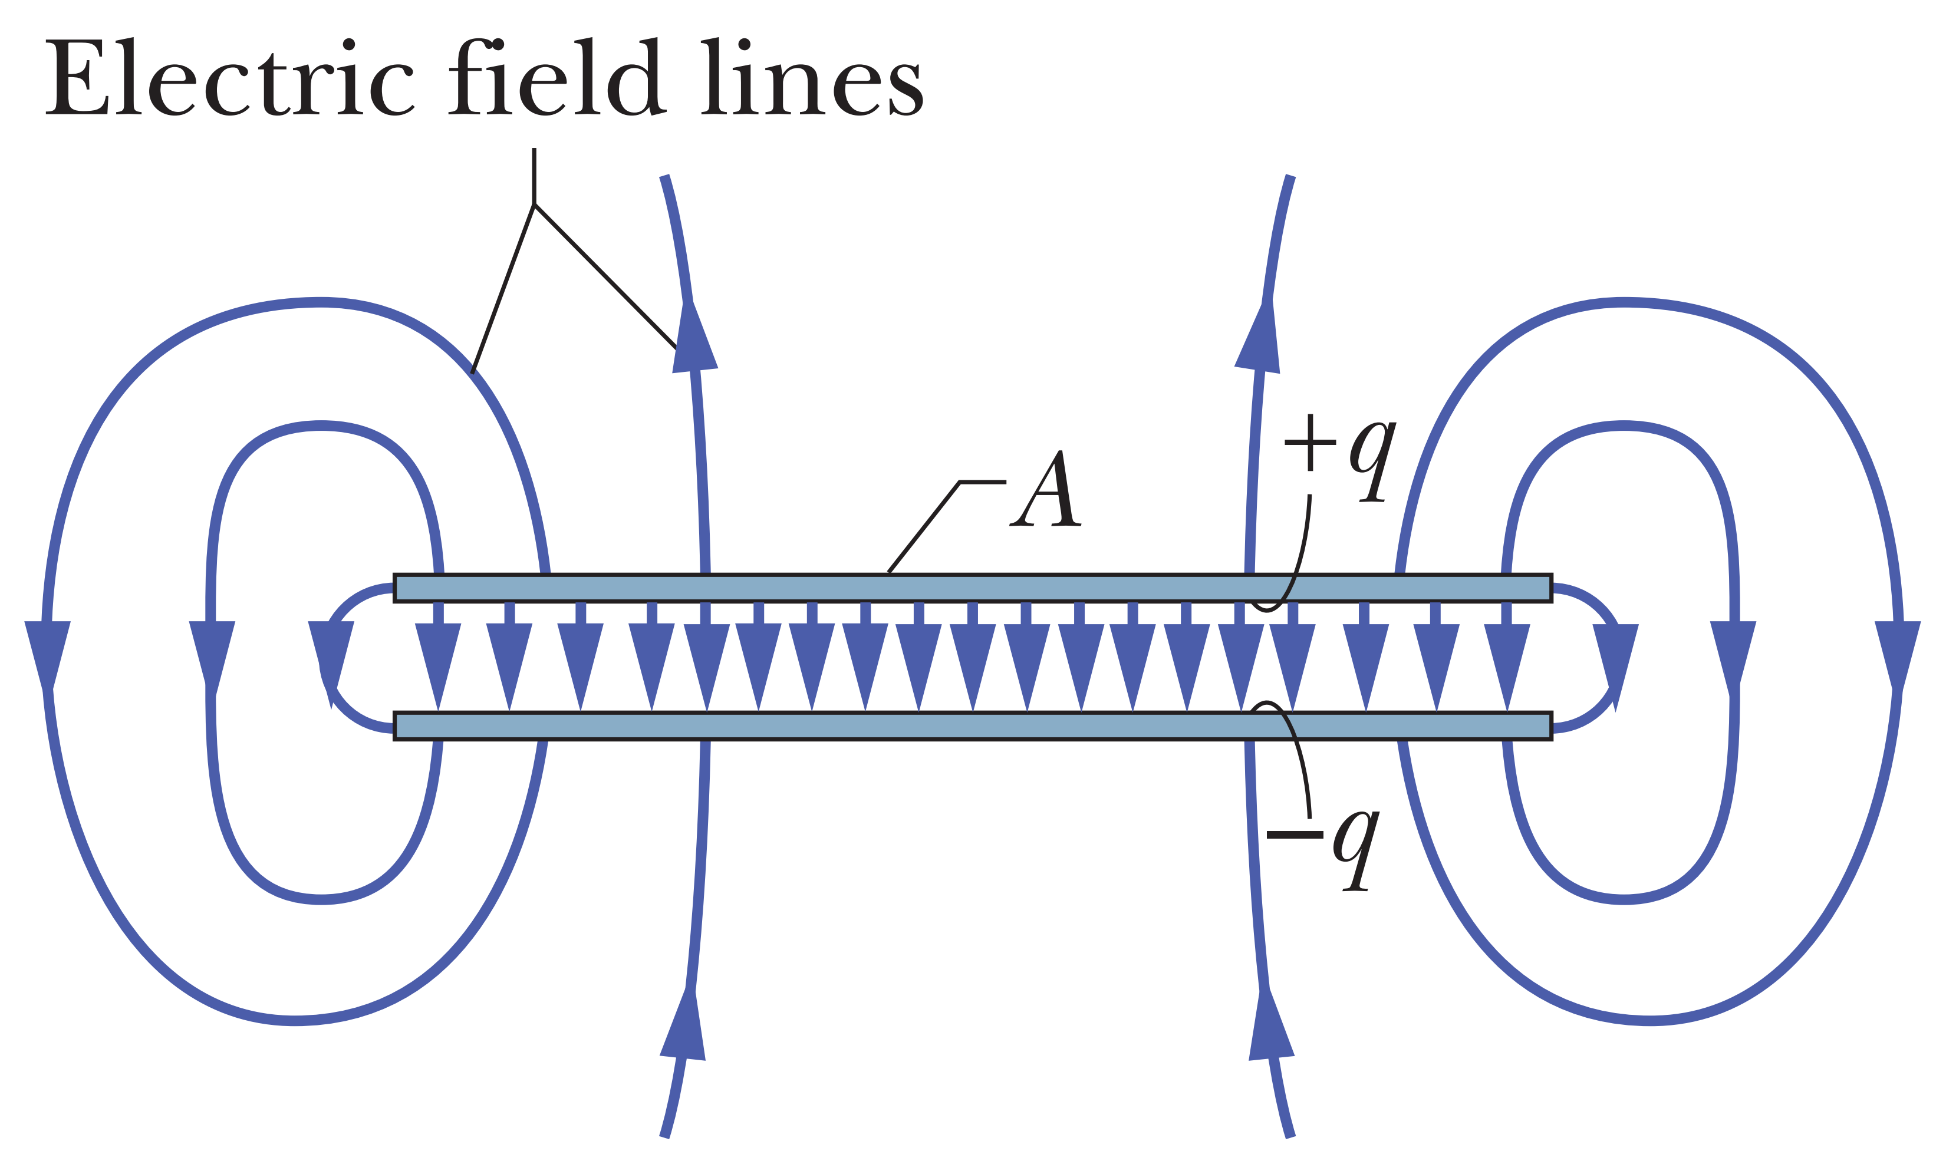

Capacitor
● A capacitor consists of two isolated conductors (the plates) with charges +q and –q. Its capacitance C is defined from q = CV
The symbol is

Slide 3
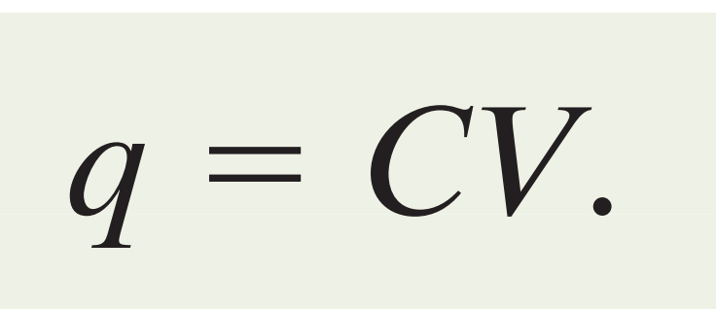
q the charge of a capacitor, V potential difference, C capacitance
Capacitance: The capability of how much charge a capacitor can store.

Slide 4
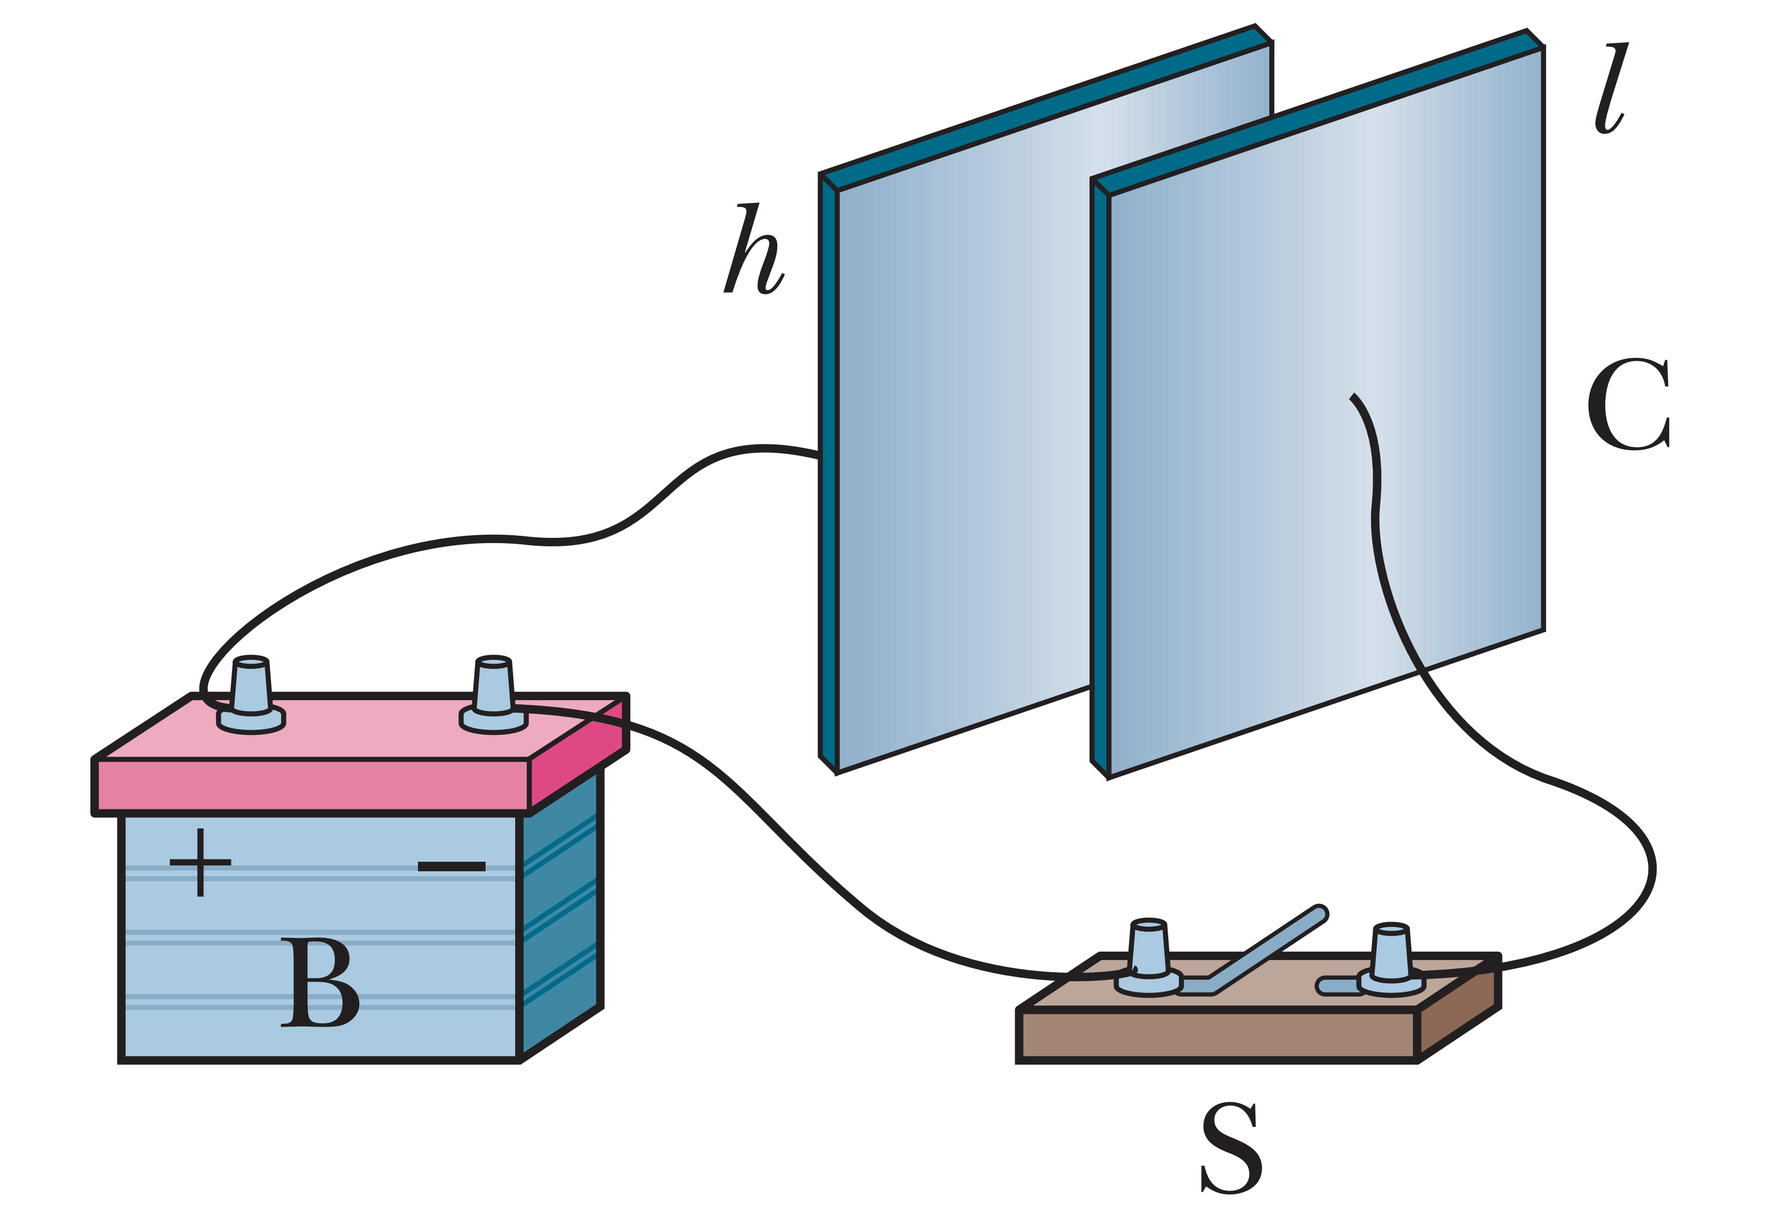
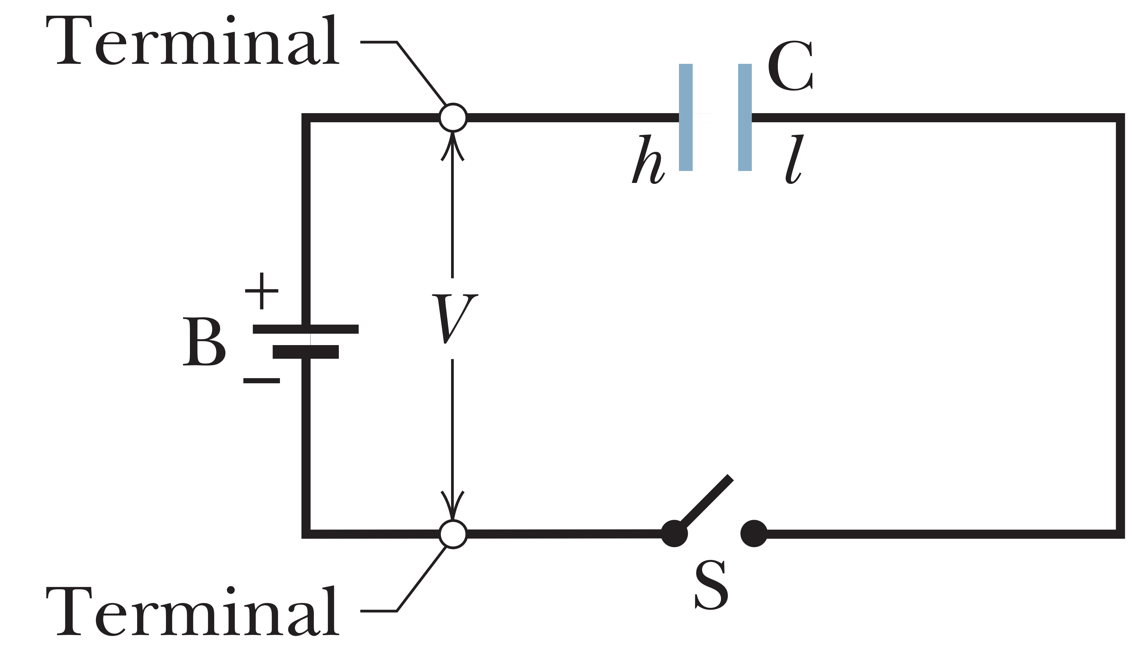
Charging a Capacitor
An electric circuit is a path through which charge can flow. A battery is a device that maintains a certain potential difference between its terminals by means of internal electrochemical reactions in which electric forces can move internal charge.
The terminal of higher potential is labeled + and is often called the positive terminal; the terminal of lower potential is labeled - and is often called the negative terminal

Slide 5
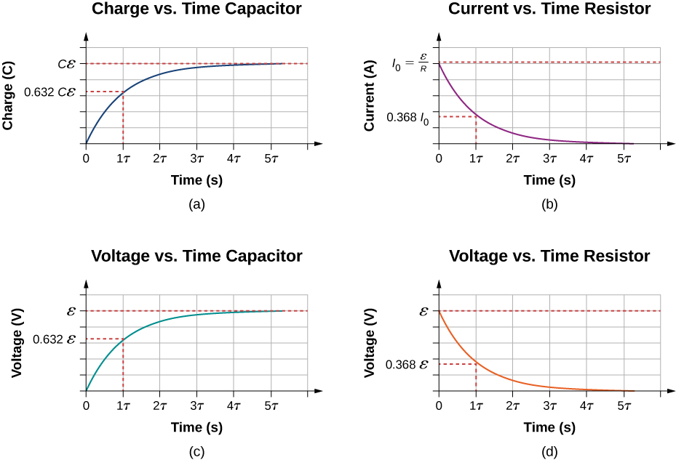
Charging Capacitor

Slide 6
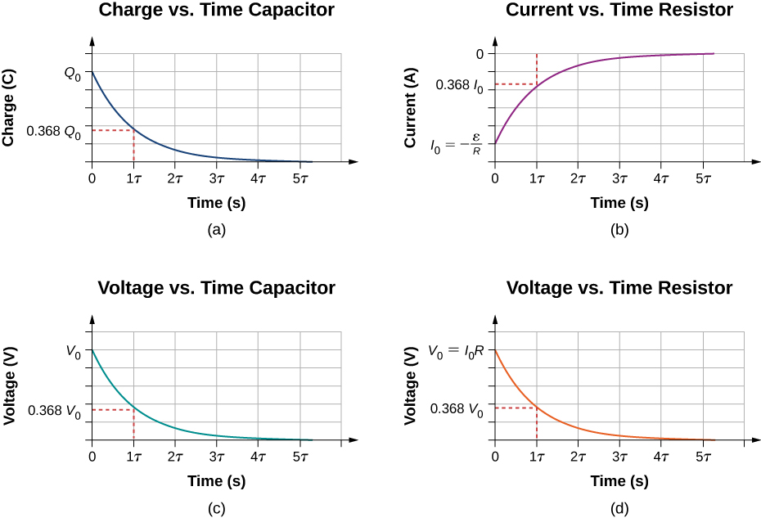
Discharging Capacitor

Slide 7
CALCULATING THE CAPACITANCE
Assume a charge q on the plates;
calculate the electric field E → between the plates in terms of this charge, using Gauss’ law;
knowing E →, calculate the potential difference V between the plates from Eq. 24-18; (4) calculate C from Eq. 25-1

Slide 8
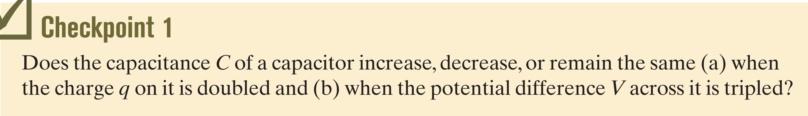
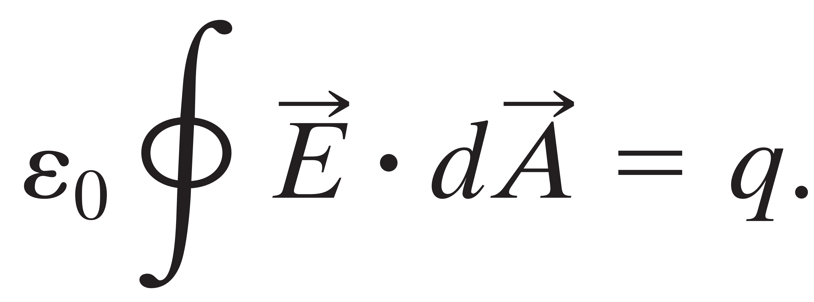
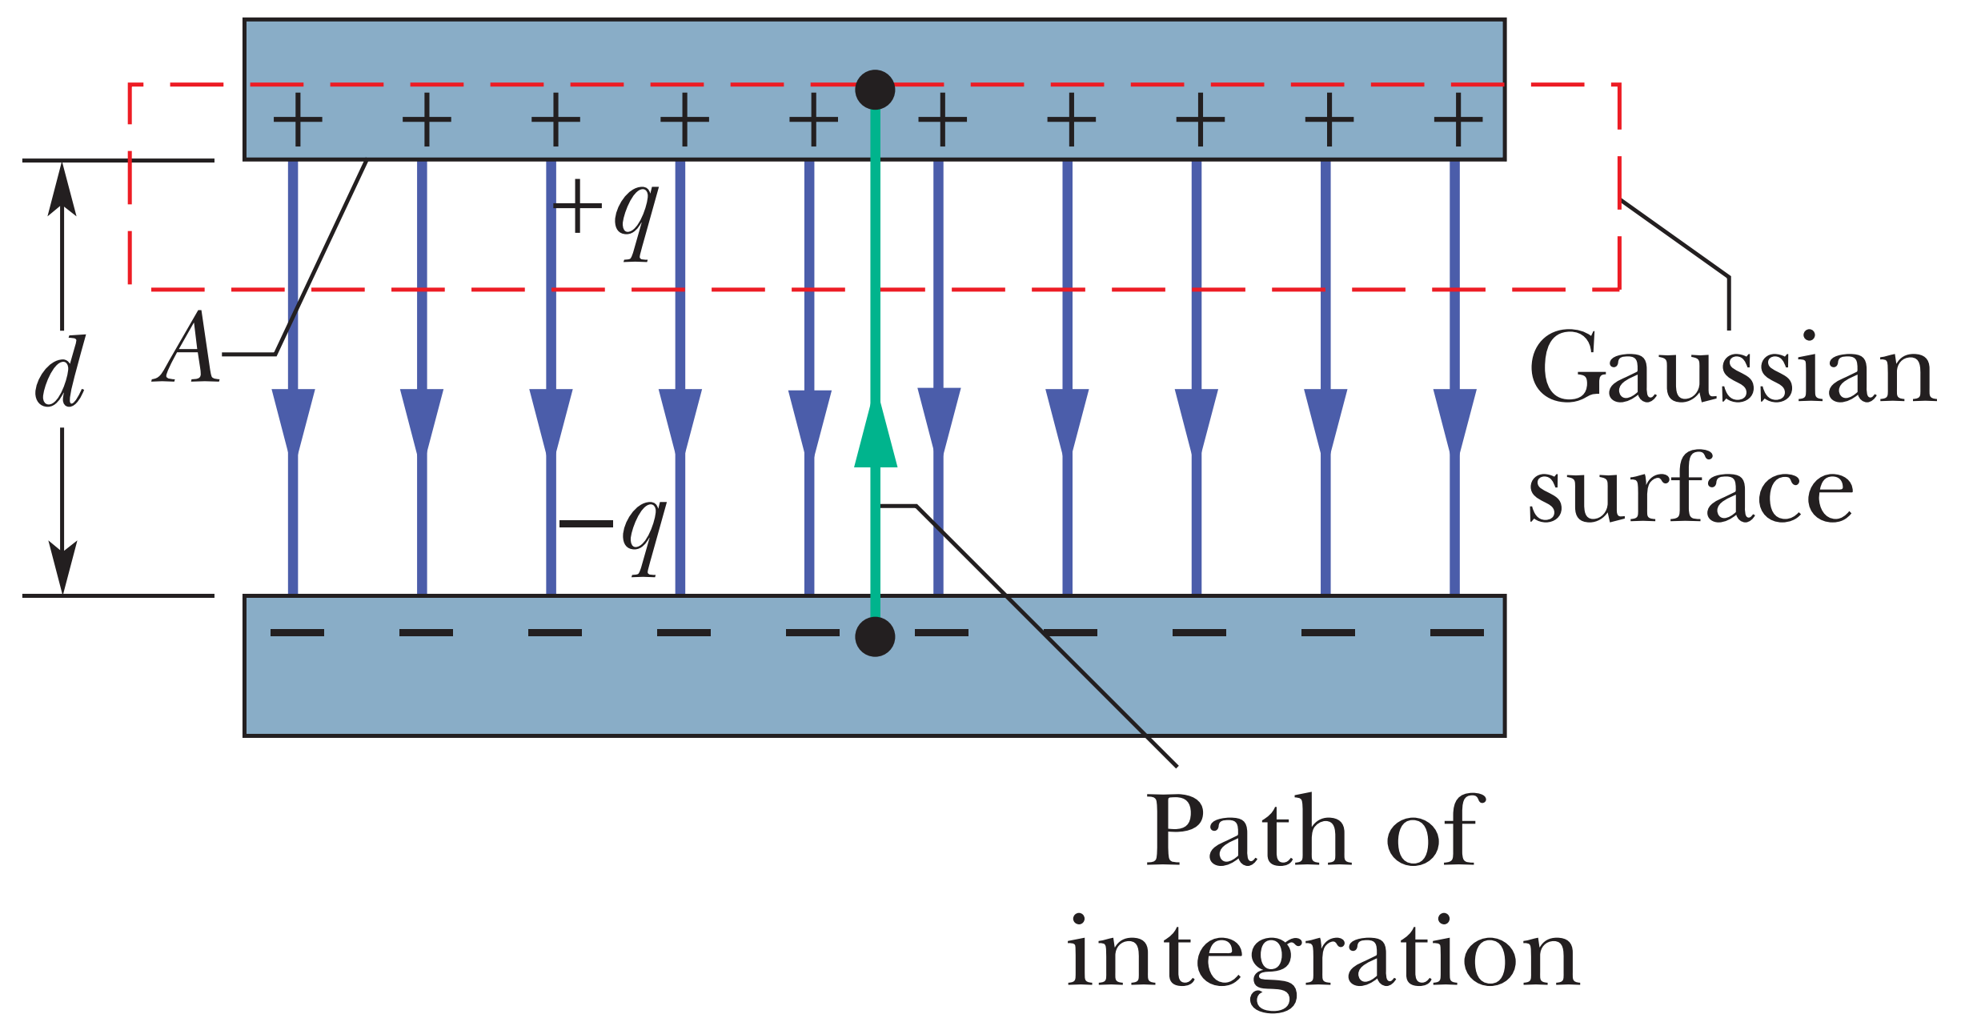
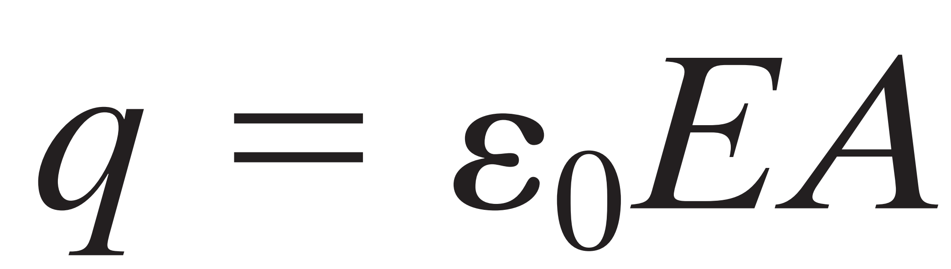
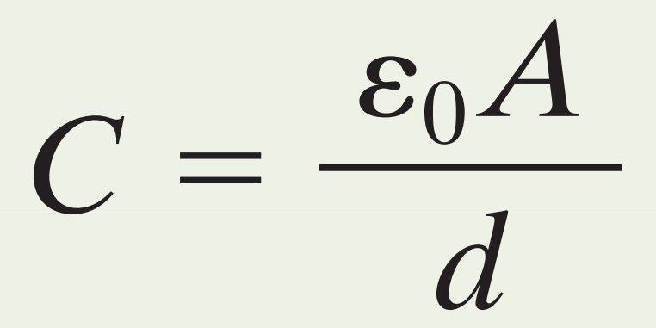
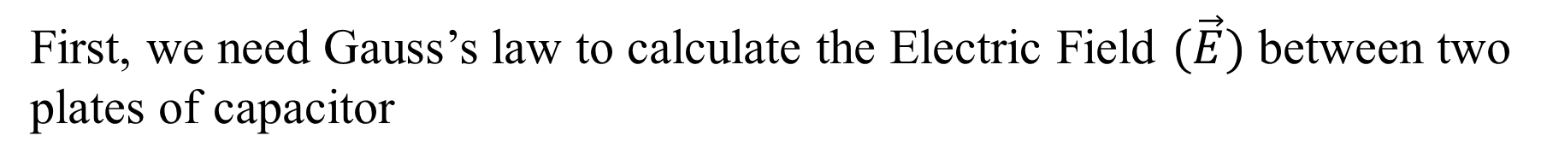
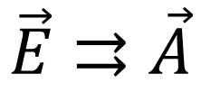
(a) same; (b) same
CALCULATING THE CAPACITANCE
First, we need Gauss’s law to calculate the Electric Field $(\vec{E})$ between two
plates of capacitor
electric flux for enclosed q
$$\vec{E}⇉\vec{A}$$

Slide 9
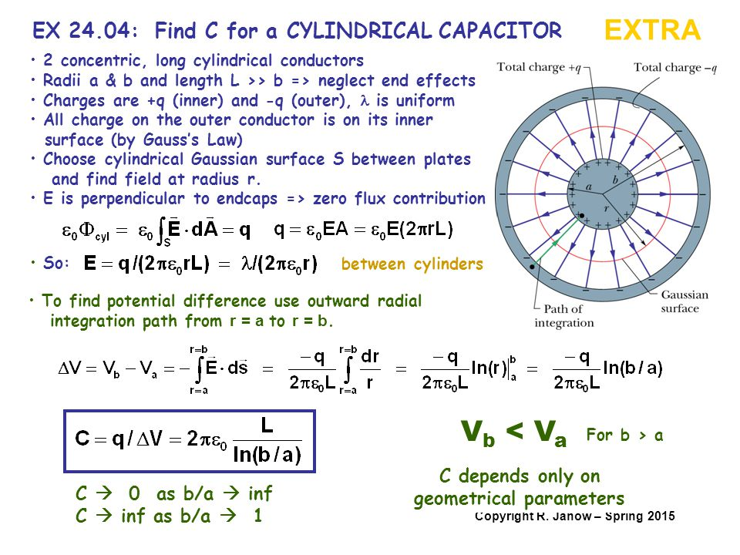

Slide 10
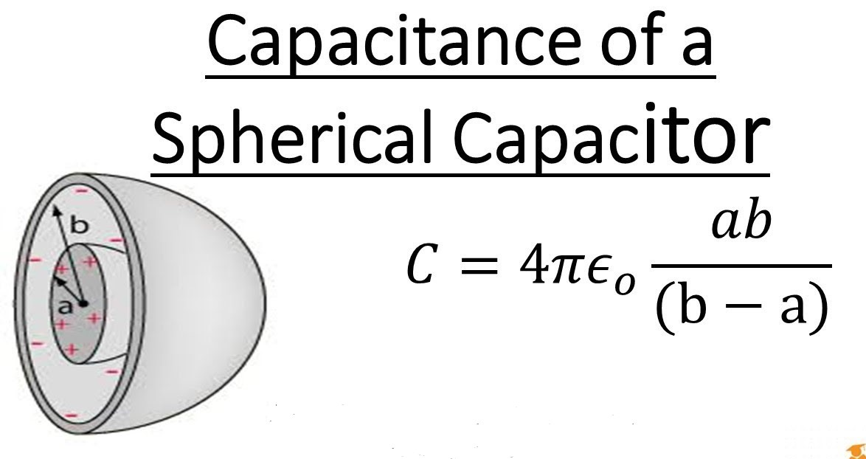

Slide 11
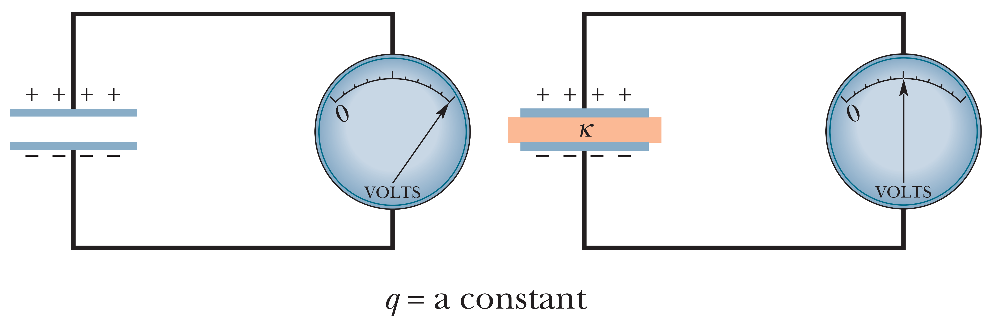
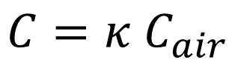
CAPACITOR WITH A DIELECTRIC
Dielectric is insulating materials.
IF we put dielectric between two plates, the capacitance will be increased by numerical factor κ, which is called Dielectric constant.
$$C=κ C_{air}$$

Slide 12
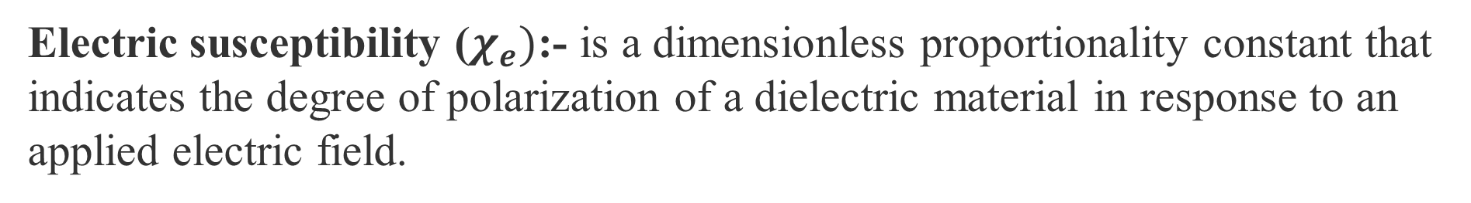
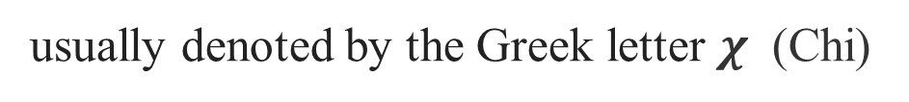
susceptibility
usually denoted by the Greek letter $χ$ (Chi)
In physics, the susceptibility of a material or substance describes its response to an applied field. Examples, Magnetic susceptibility, Electric susceptibility.
Electric susceptibility ($χ_{e})$:- is a dimensionless proportionality constant that
indicates the degree of polarization of a dielectric material in response to an
applied electric field.
Permittivity
usually denoted by the Greek letter ε (epsilon).
It characterizes the tendency of the atomic charge in an insulating material to polarize in the presence of an electric field. The larger the tendency for charge polarization (also called electric polarization), the larger the value of the permittivity.
Notes:
A material with high permittivity polarizes more in response to an applied electric field than a material with low permittivity, thereby storing more energy in the material.

Slide 13
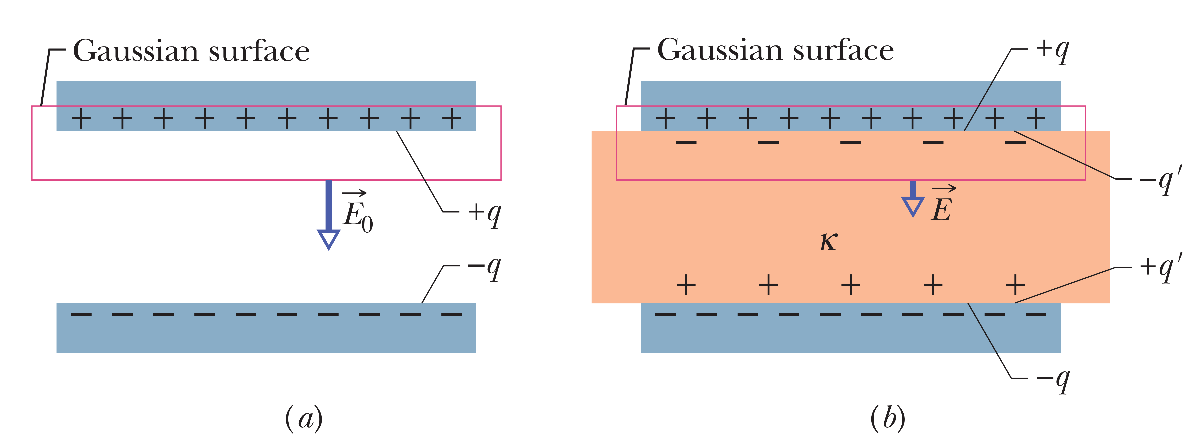
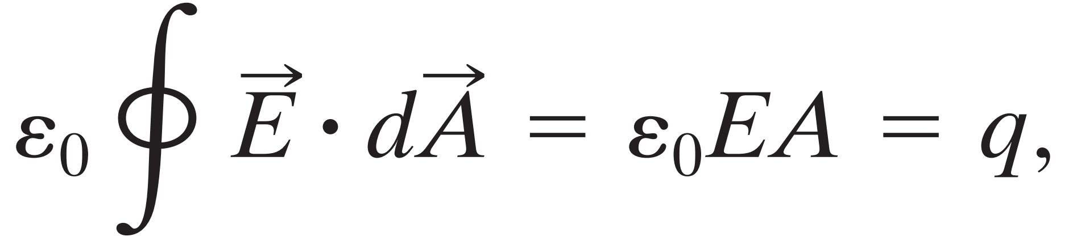
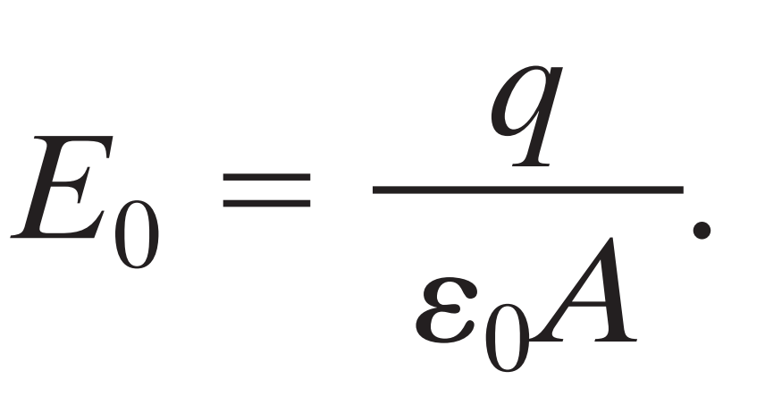
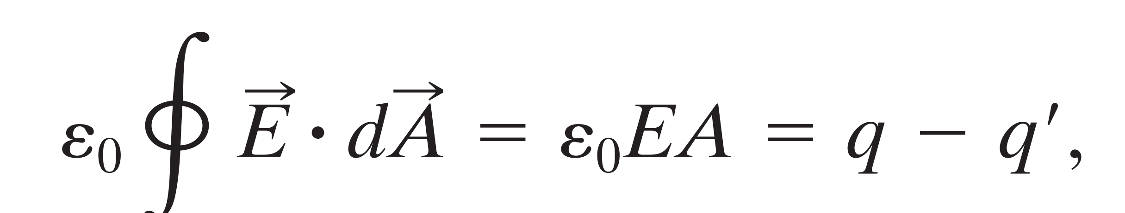
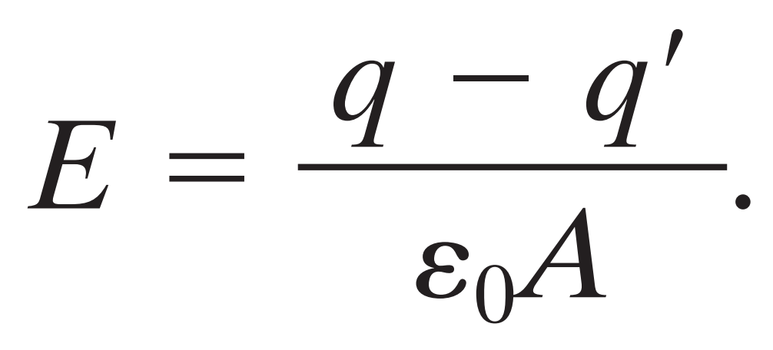
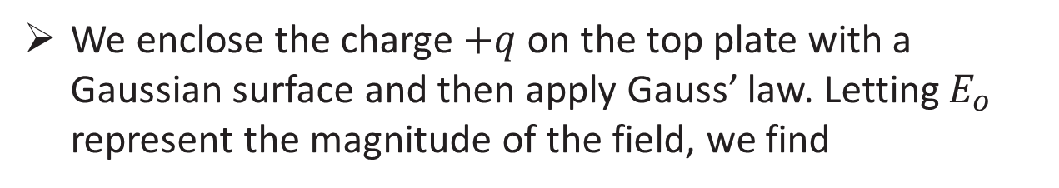
Dielectrics and Gauss’ Law
We enclose the charge $+q$ on the top plate with a Gaussian surface and then apply Gauss’ law. Letting $E_{o}$ represent the magnitude of the field, we find
Without dielectric
With dielectric

Slide 14
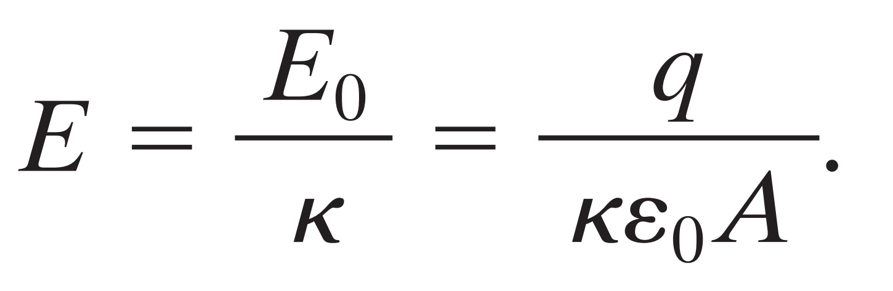
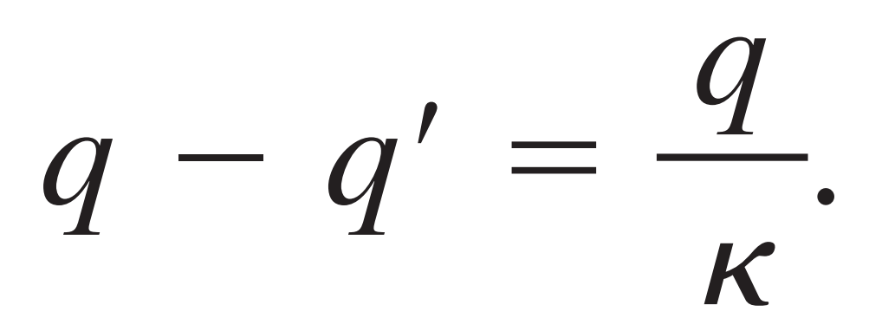
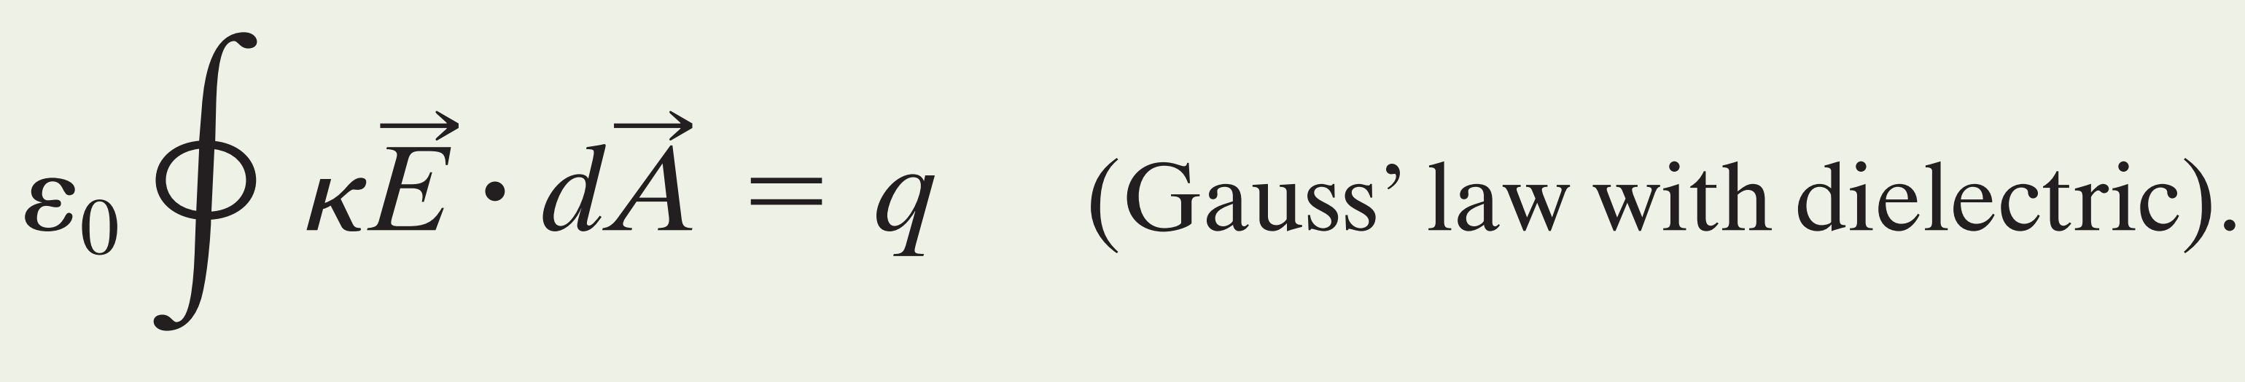
Compare with
The effect of the dielectric is to weaken the original field $E_{o}$ by a factor of $k$; so we may write

Slide 15
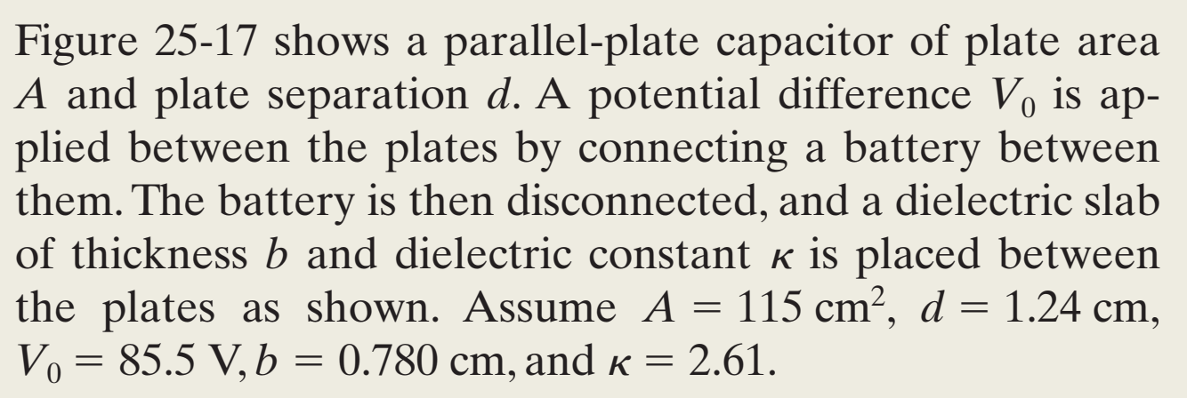
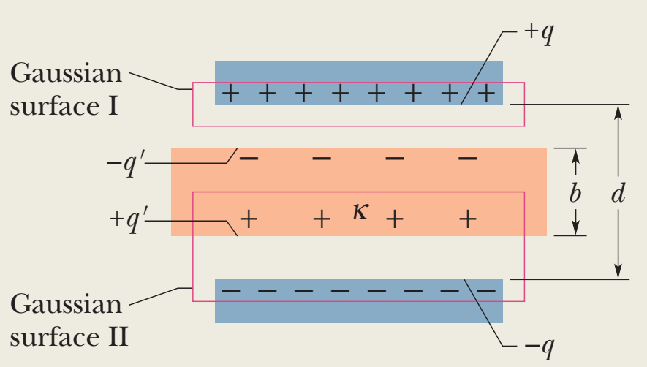
Sample Problem 25.06

Slide 16
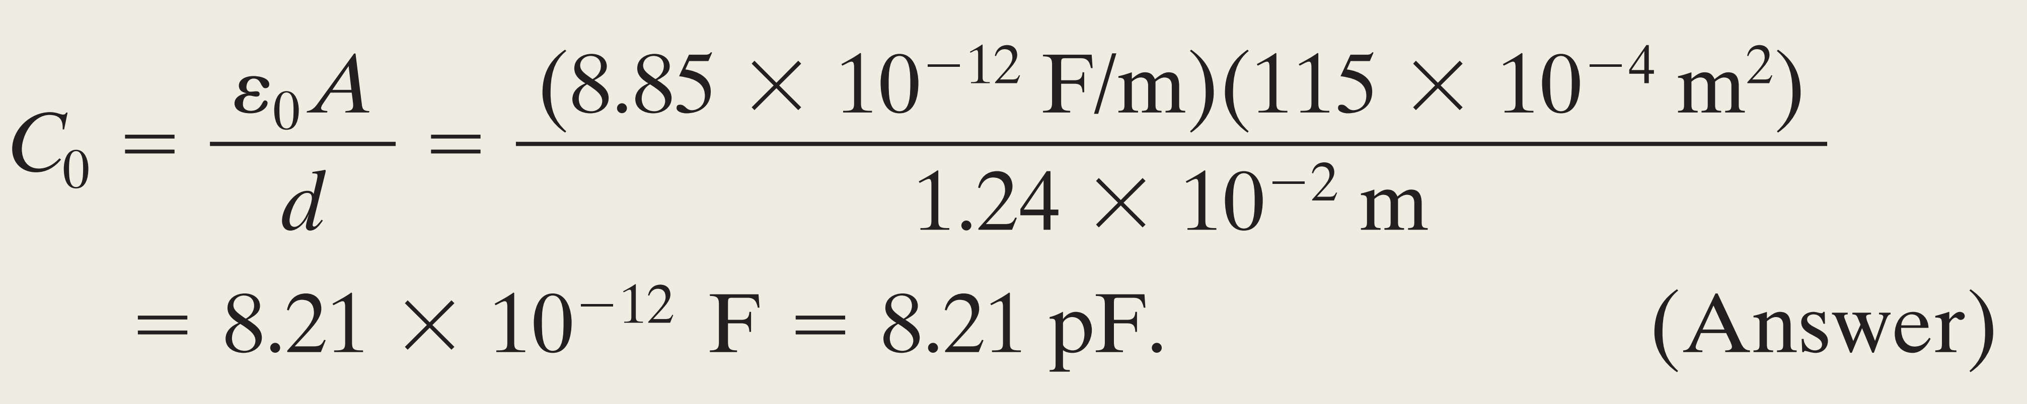
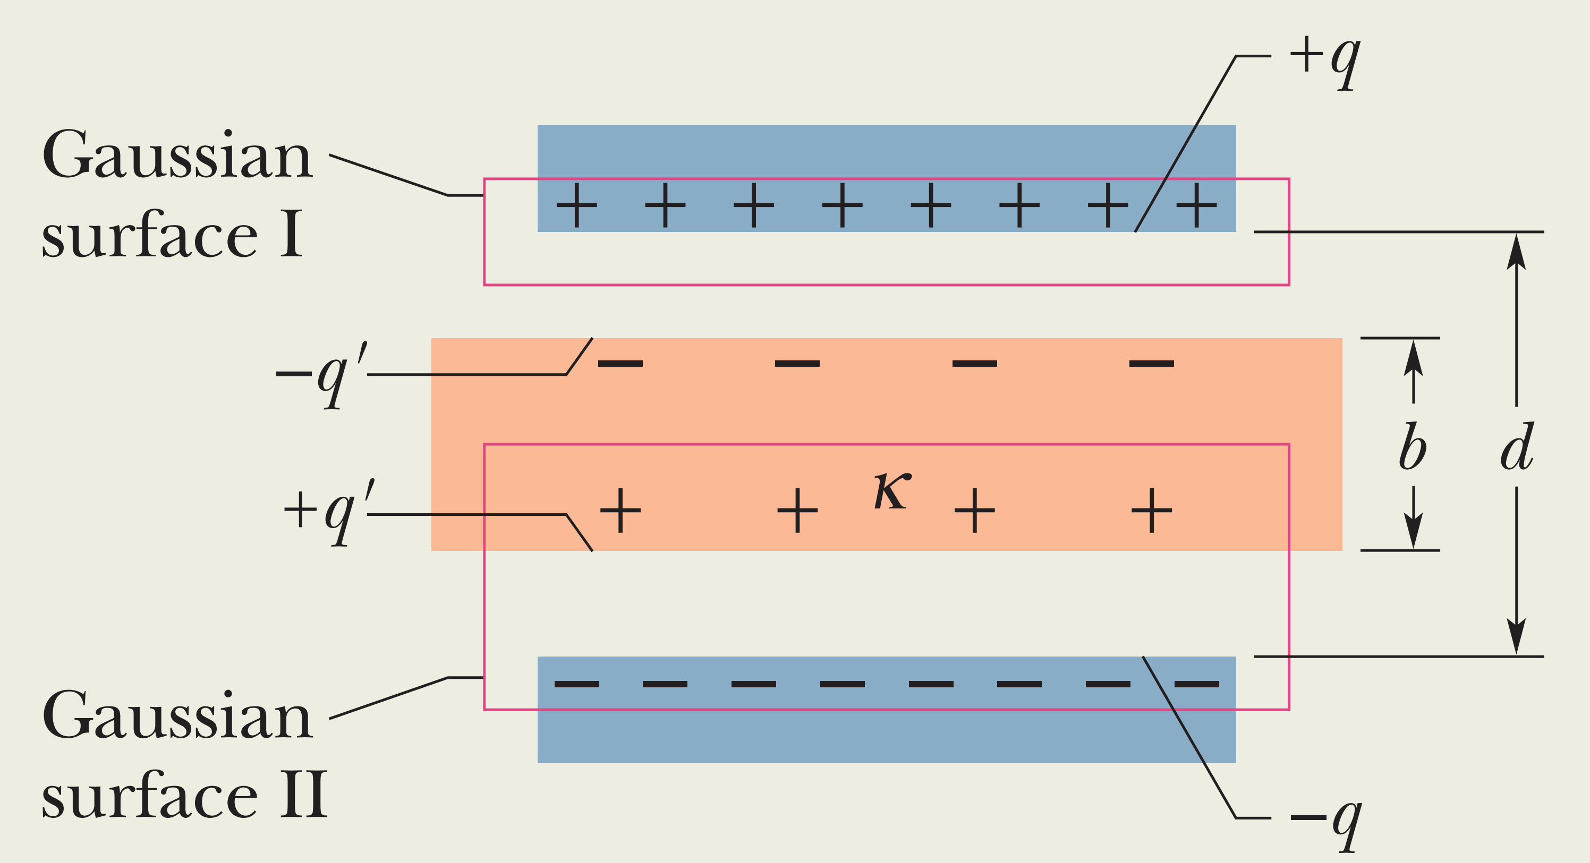
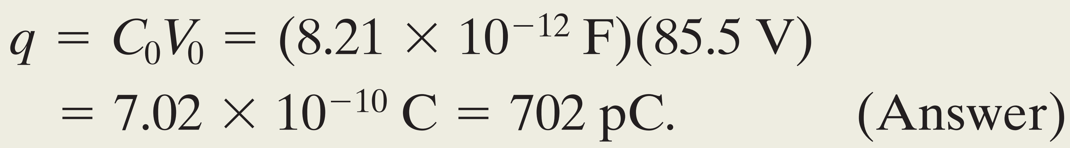
We have
(a) What is the capacitance $C_{o}$ before the dielectric slab is inserted?
(b) What free charge appears on the plates?

Slide 17
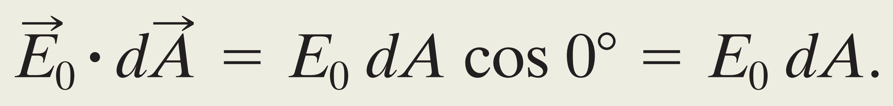
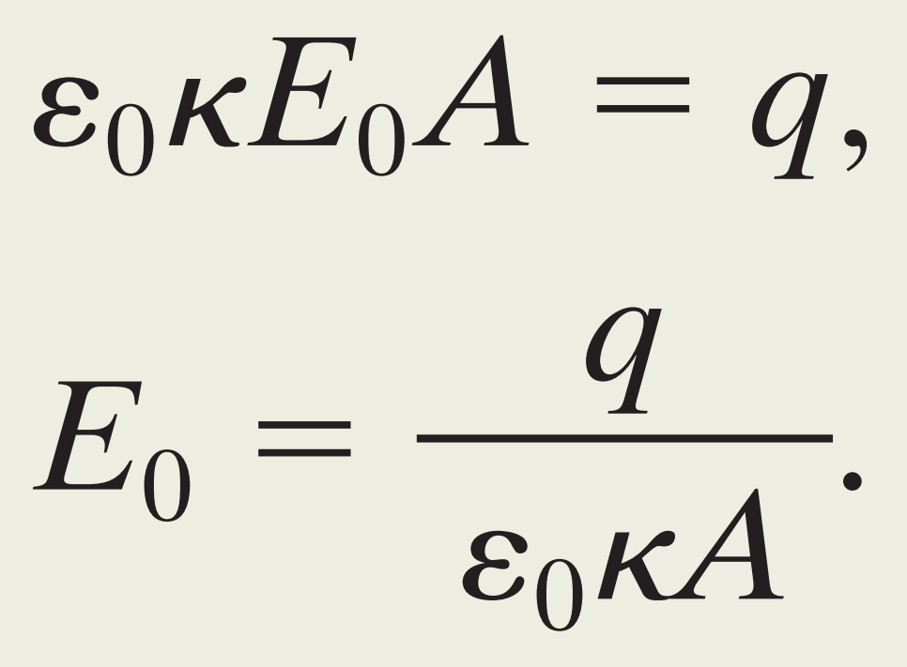
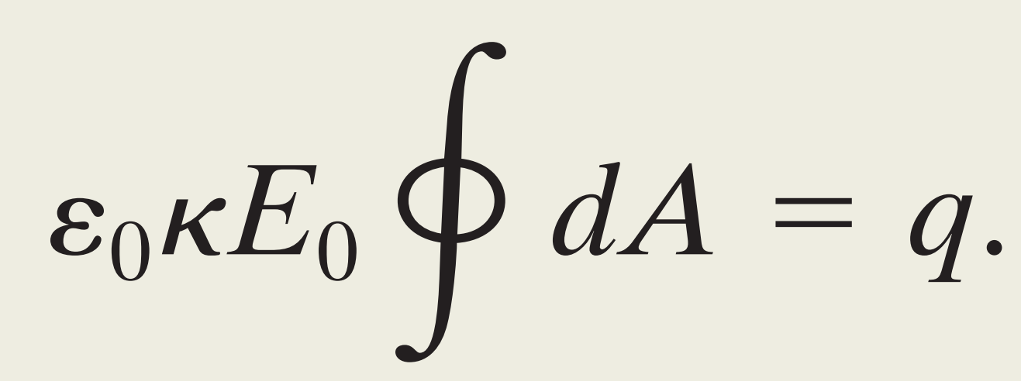
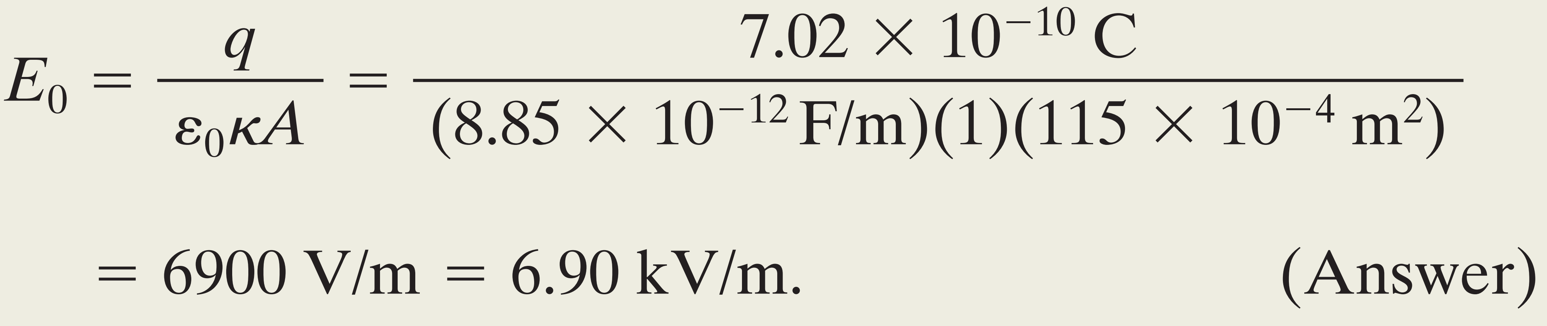
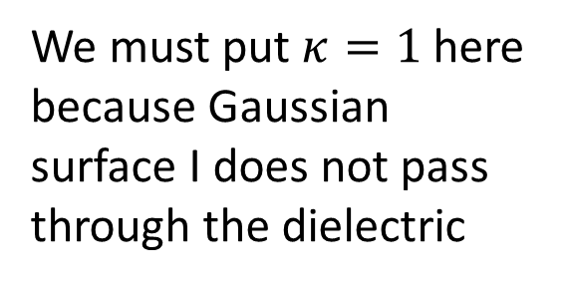
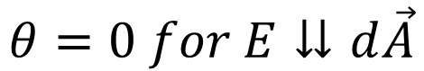
(c )What is the electric field $E_{o}$in the gaps between the plates and the dielectric slab?
Gaussian surface I
$$θ=0 for E⇊d\vec{A}$$
We must put $κ=1$here because Gaussian surface I does not pass through the dielectric

Slide 18
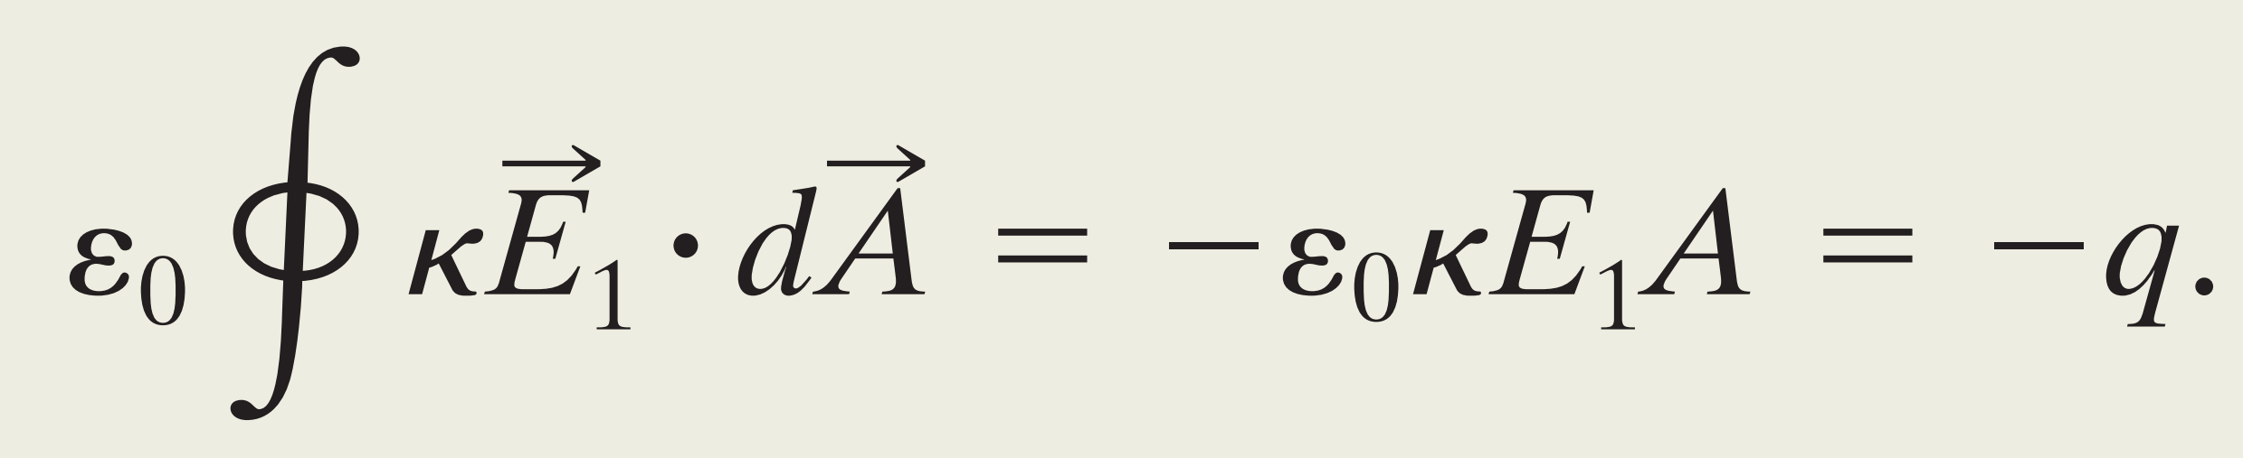
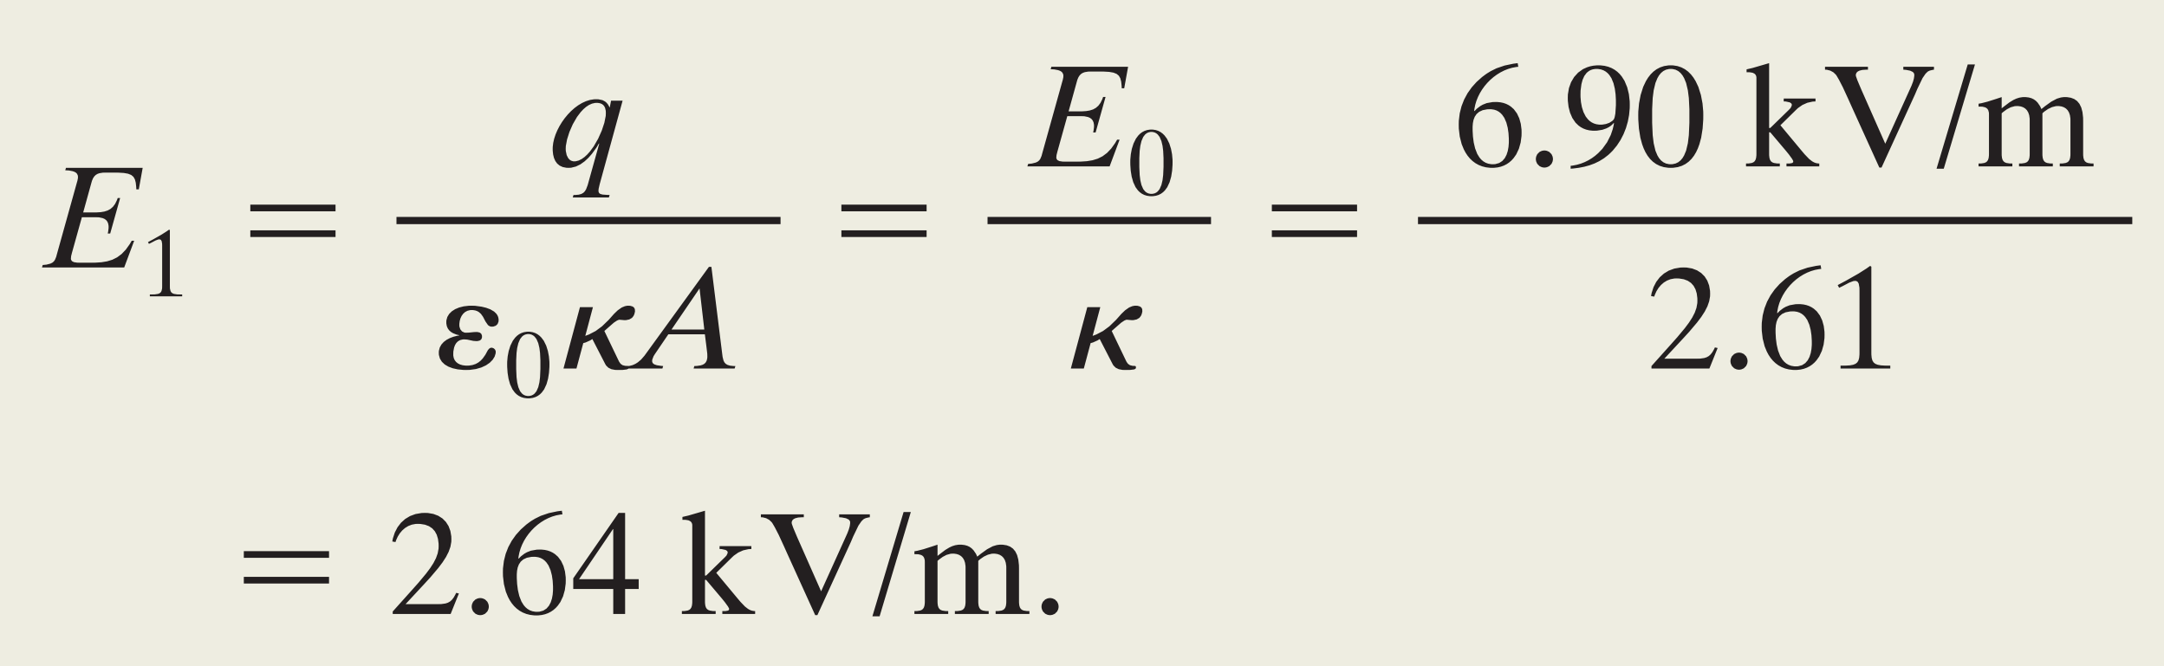
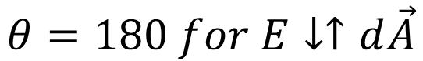
(d) What is the electric field $E_{1}$ in the dielectric slab?
Gaussian surface II
$$θ=180 for E↓↑d\vec{A}$$

